Slide 1

3D Puzzle 3D printing algorithms course
Roy kinamon & alon mendelson

Slide 2
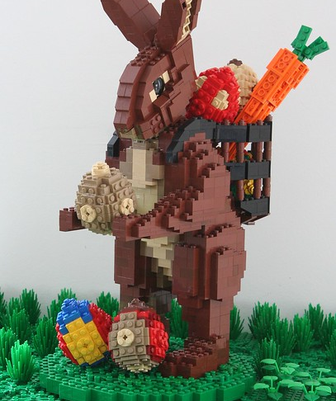
Outline and Motivation
Motivation
gain experience with 3D algorithms coding and hands on 3D printing
Outline
Input: 3D body for print
Output: Set of 3D printable puzzle pieces:
Built into original shape
Maintain stability and strength
Efficient run time and easy printing

Slide 3
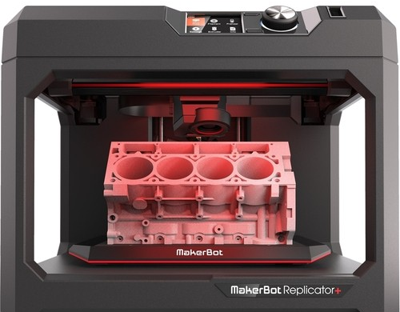
Framework
3D representation and manipulation
Trimesh
Blender and OpenScad (for Boolean operations)
Printing
MakerBot Replicator

Slide 4
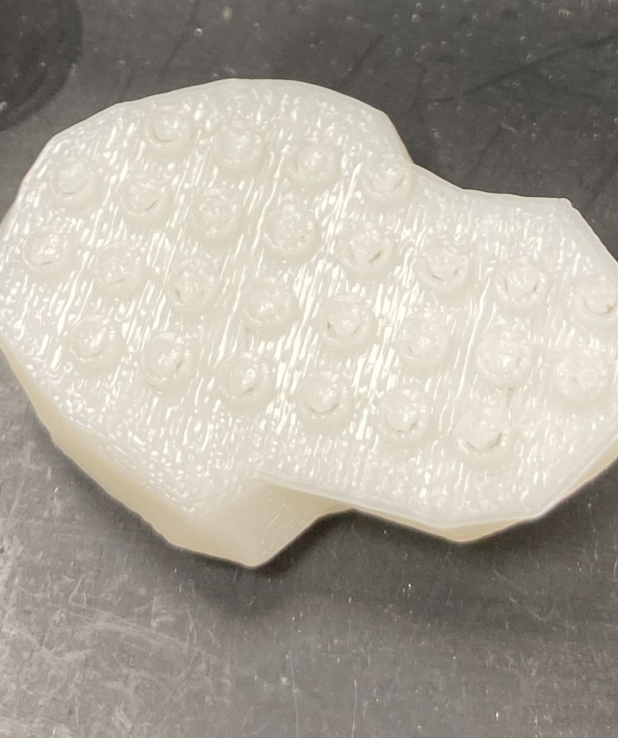
Algorithm stages – Slicing along Z
Optimize to keep cross section above minimal area
Keep continuity in xy plane
Represent slices with a Boolean grid of contained bolts and voids

Slide 5
Algorithm stages – Plan X-Y Slicing
Recursive algorithm that runs on the Boolean representation with constraints
Pieces not too big and not to small
Strong connection to adjacent layers
No overlapping cuts between adjacent layers

Slide 6
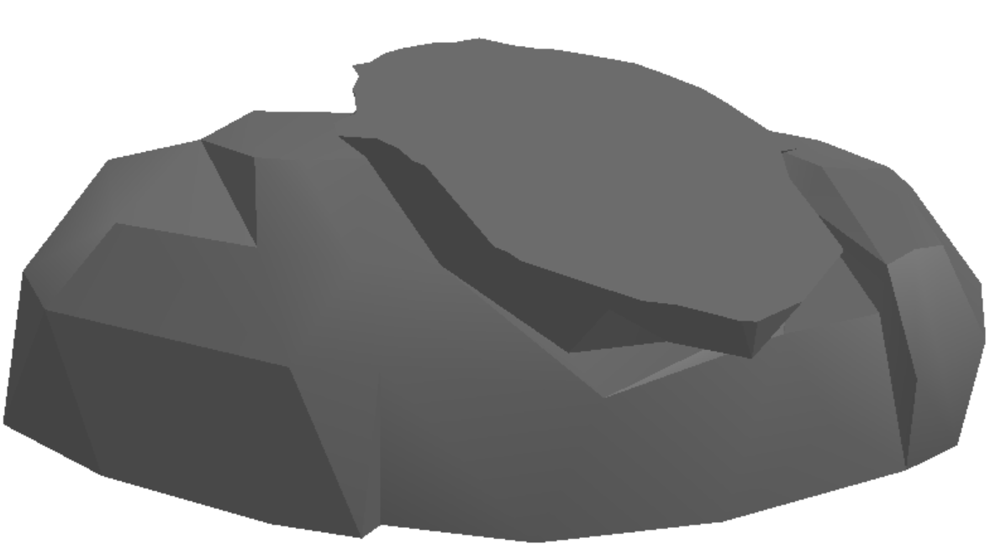
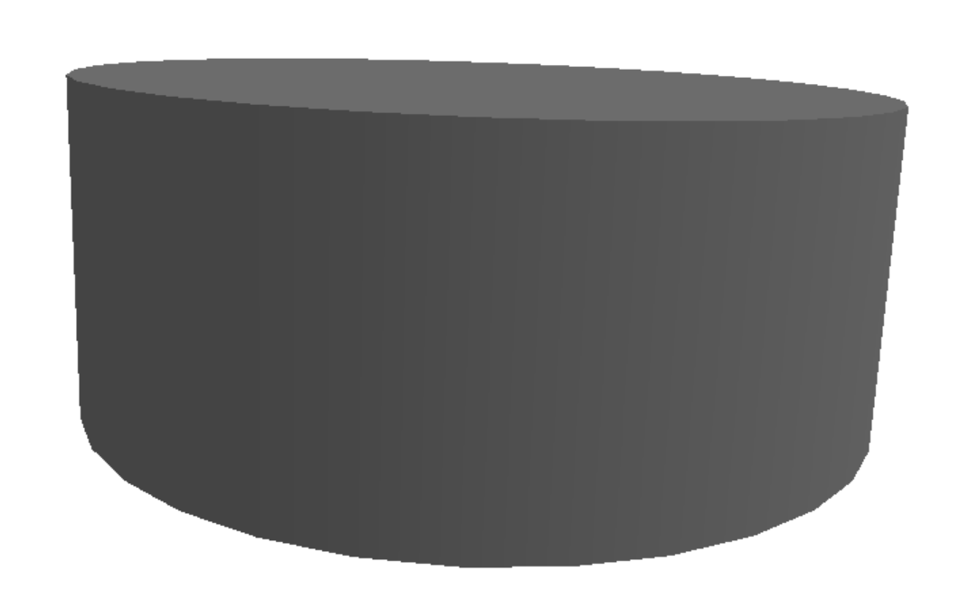
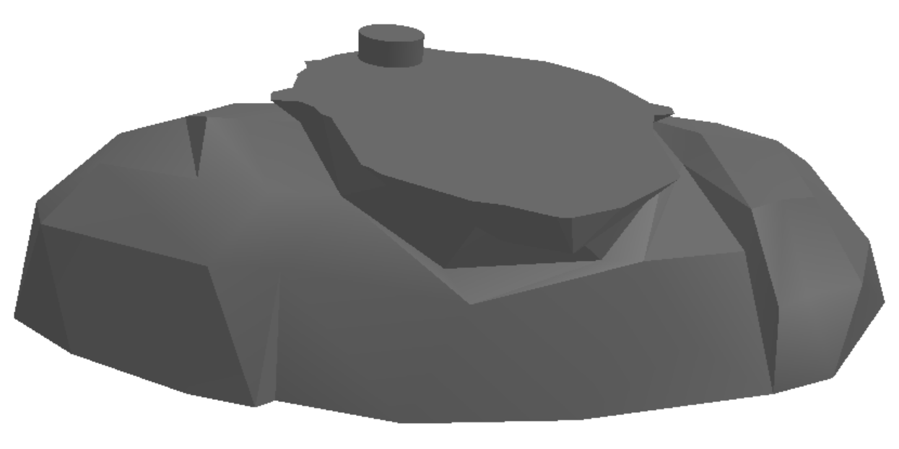
Algorithm stages – Add “Connectors” and slice
Add the bolts and the voids to each layer using Boolean operations
Perform slicing along x-y

Slide 7
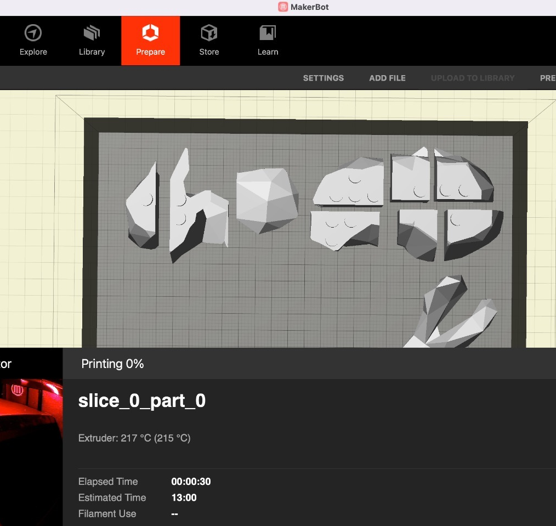
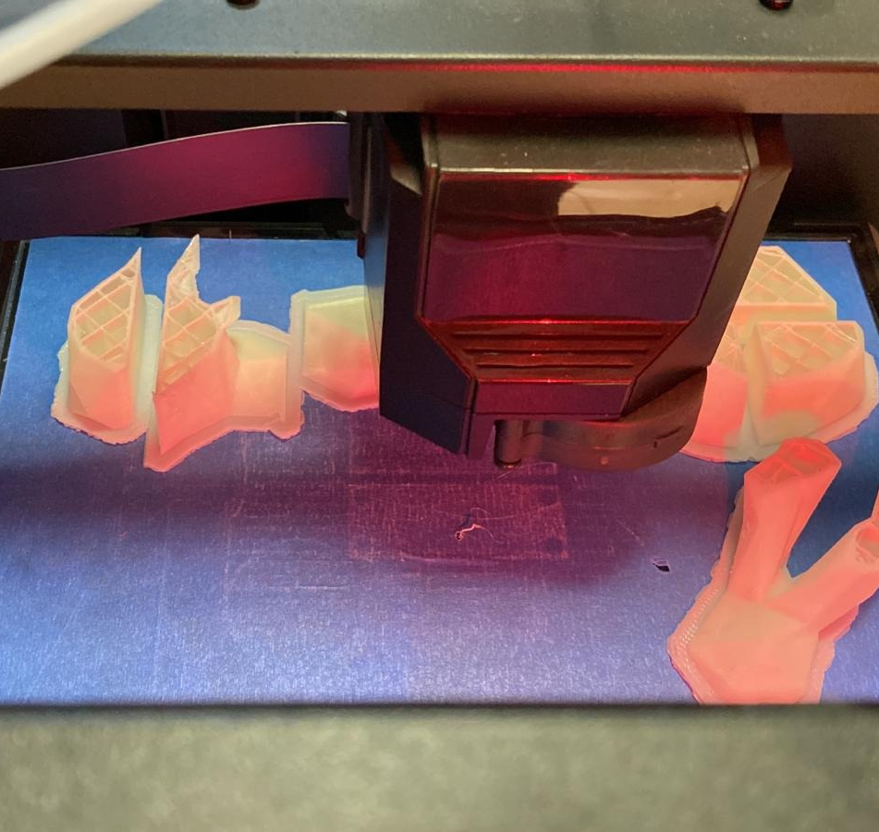
Print initial model in MakerBot replicator

Slide 8
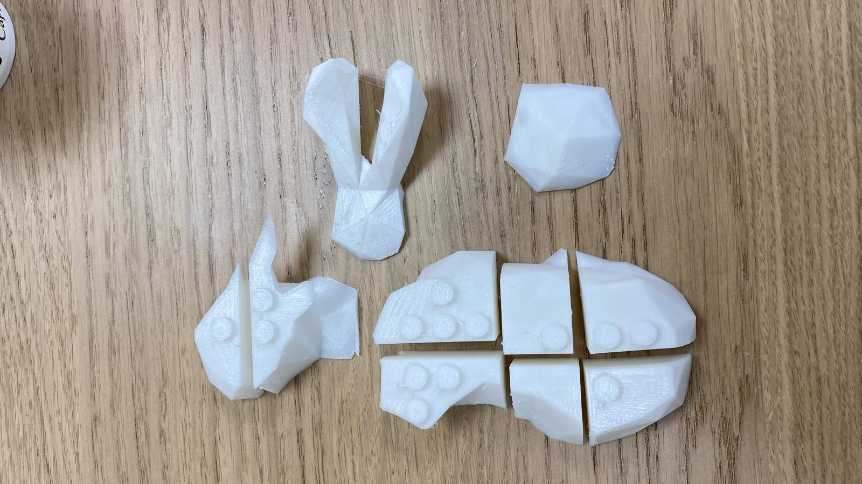
2nd iteration Bolts and voids Fine Tuning
MakerBot resolution is low
Requires to asjust bolt and voids dimentions for ease of assembly
Do the above while maintaining physical strength
Testing different dimensions and density for bolts

Slide 9
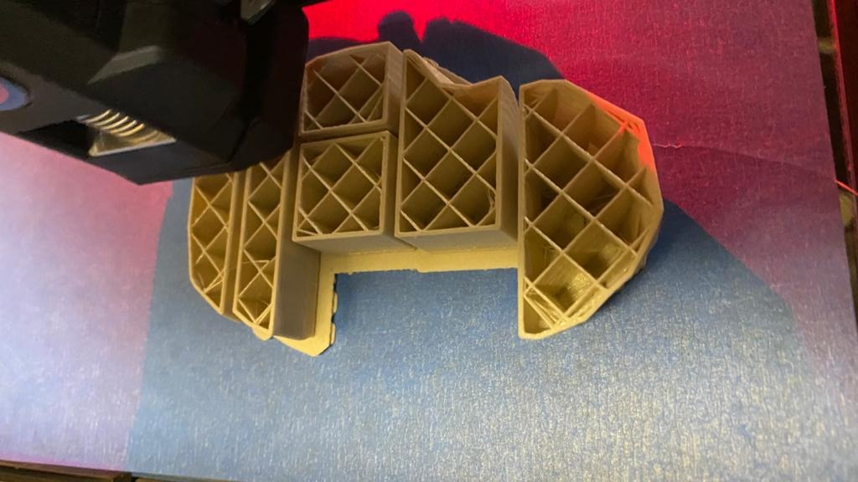
Optimizing Structure strength
P
d_{xy}
Measuring strength of single bolt over moment
Calculate total structure length and siameter
Trial 1 – make it stand - aborted
Filling
Shape
Trial 2
Modifying bolt dimensions from friction to
breaking pressure / flexural strength
Could not be completed due to makerbot print accuracy (different results per print)
h_{xy}

Slide 10
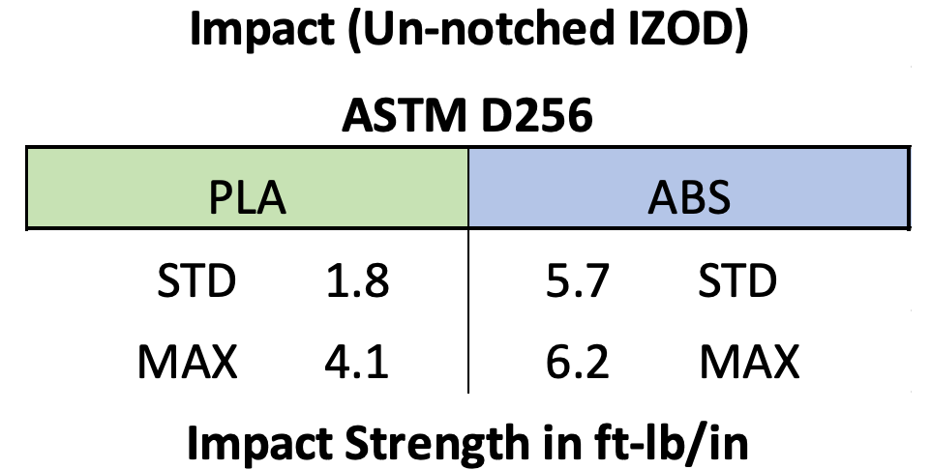
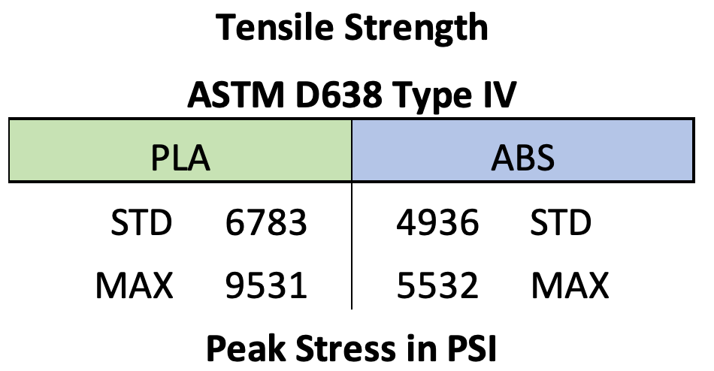
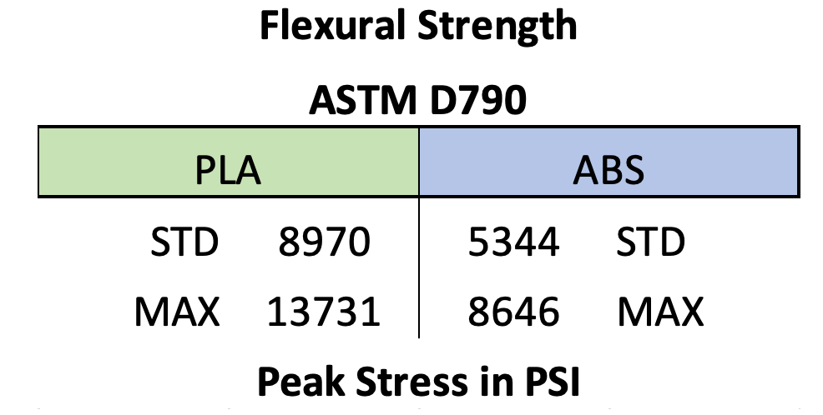
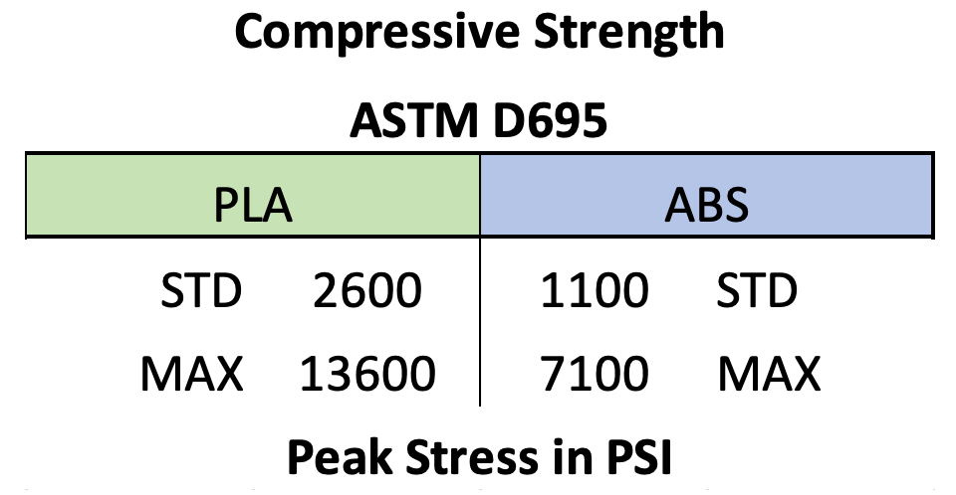
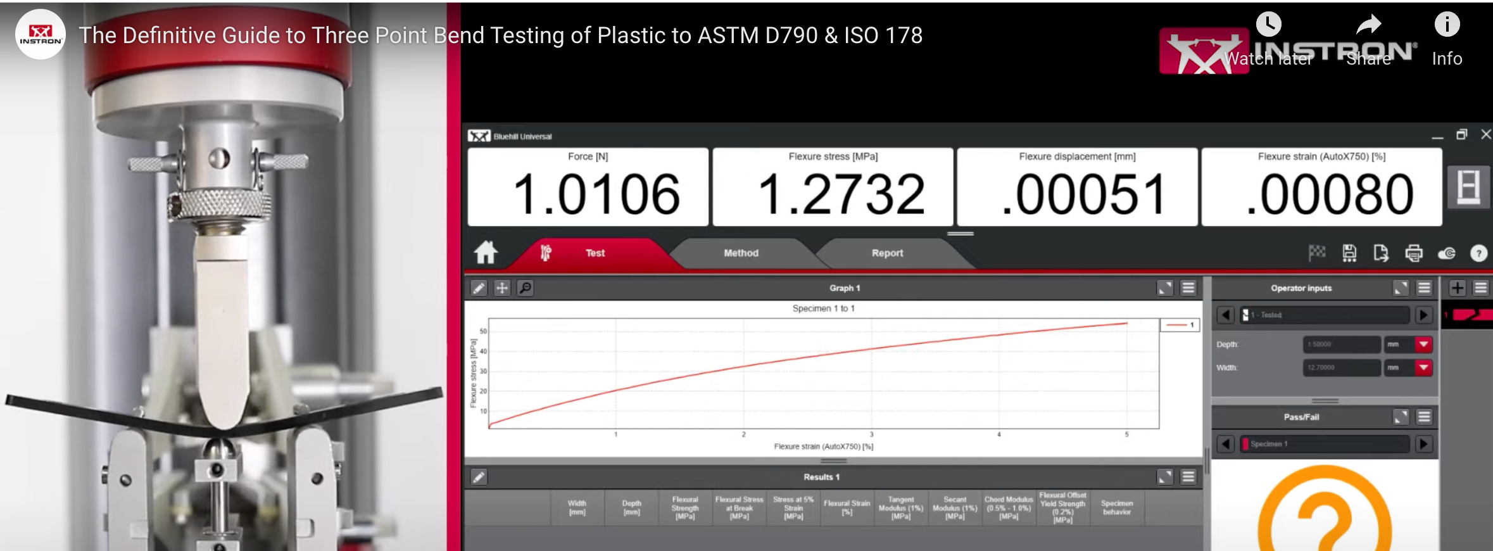
Optimizing Structure strength
Increase height and break resistance
Infill (Higher infill for a stronger part)
Shells (More shells for a stronger part)
Print orientation, size or design
Increase diameter of bolts till meeting flexural strength

Slide 11
Challenges
Trimesh and Blender are unstable
Transition to OpenScad
Printing
Alignment and Calibration
Quality
Duration

Slide 12

Thank You

